Slide 1
Making Tools for
Making Games
Steven M. Drucker
Microsoft Research

Slide 2
Why games at all?
  Making games as an educational experience:
  “If you build it, you will learn.”
  Using games as motivational tool:
    Potential for motivating a class of students that have not been previously impacted by educational technology
    Fred Brooks and Grope
    Simulations with motivation added
    Intrinsic versus extrinsic learning
    (That boring learning stuff shoehorned into games versus building informational content into fabric of the game)
    This community believes in the utility of games.
    But, MAKING A GAME IS HARD!!!!
    So, how do we get from where we are to where we want to go?
    First, figure out where we want to be…
Notes:
Example picture here?

Slide 3
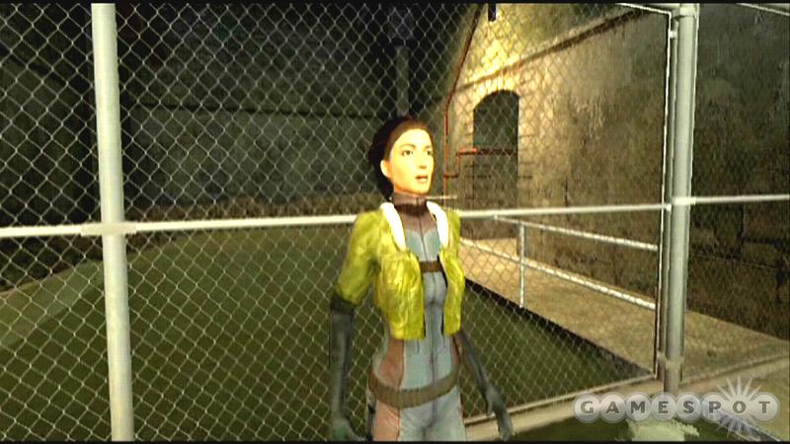
How not to merge games and education:
Before you go on, what is Newton’s 1st Law?
F=ma
F=GMm/r^2
V=IR
None of the above

Slide 4
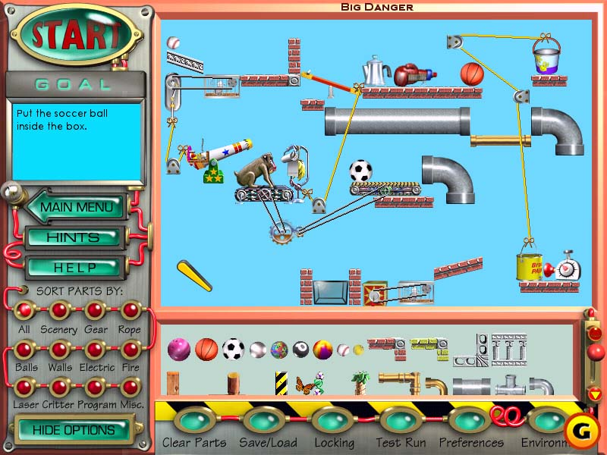
A better way of merging learning and education
Return of the incredible Machine

Slide 5
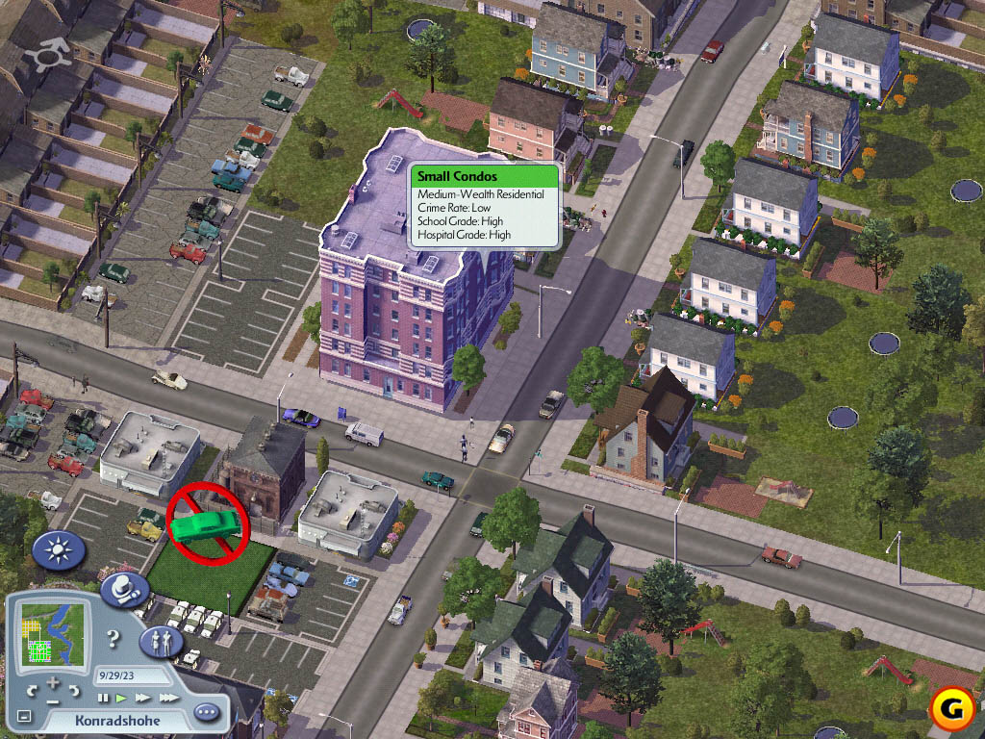
A great way to learn urban planning ☺
Simcity 4

Slide 6
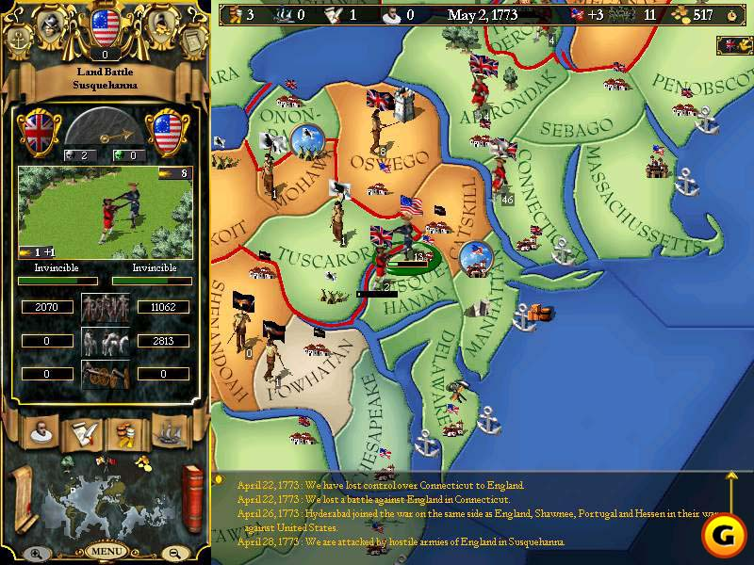
Learning history? Or just playing…
Europa Univeralis II

Slide 7
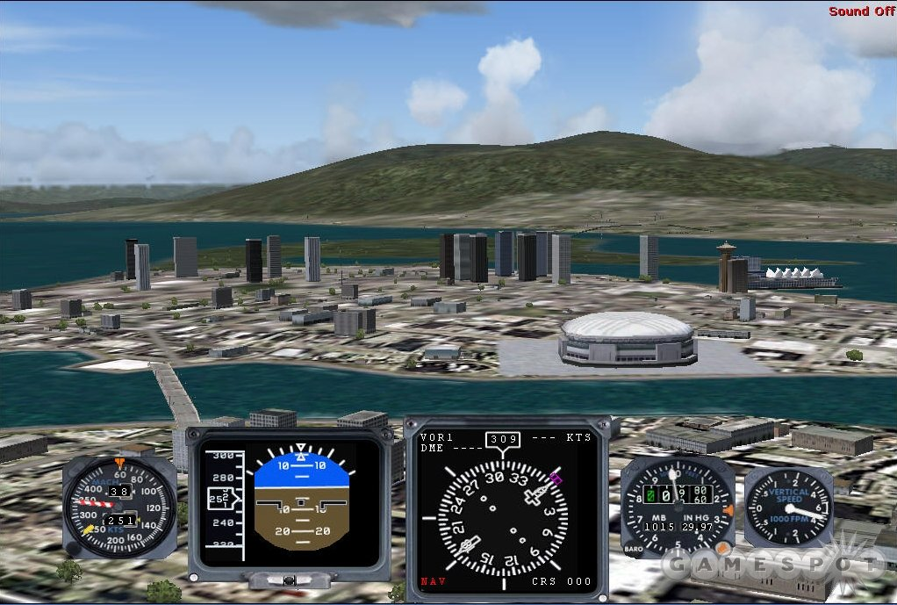
Learning to fly…
Flight Simulator 2004

Slide 8
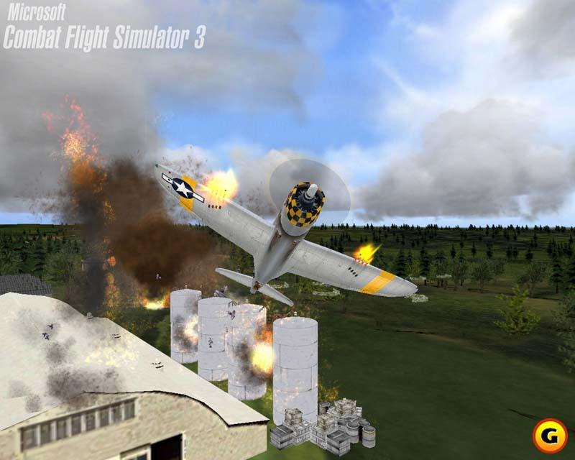
Some added motivation…
Combat Flight Simulator 3

Slide 9
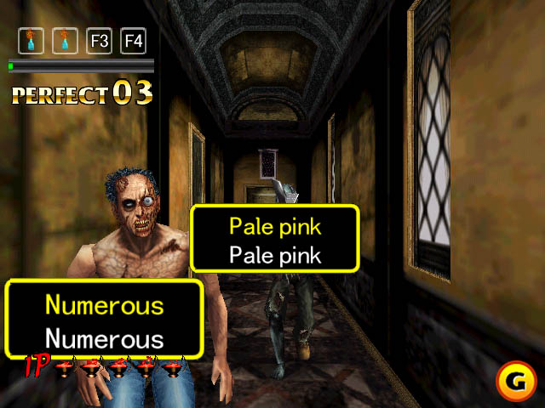
One of my favorites…
The typing of the dead

Slide 10

One of my favorites (cont).
The typing of the dead

Slide 11
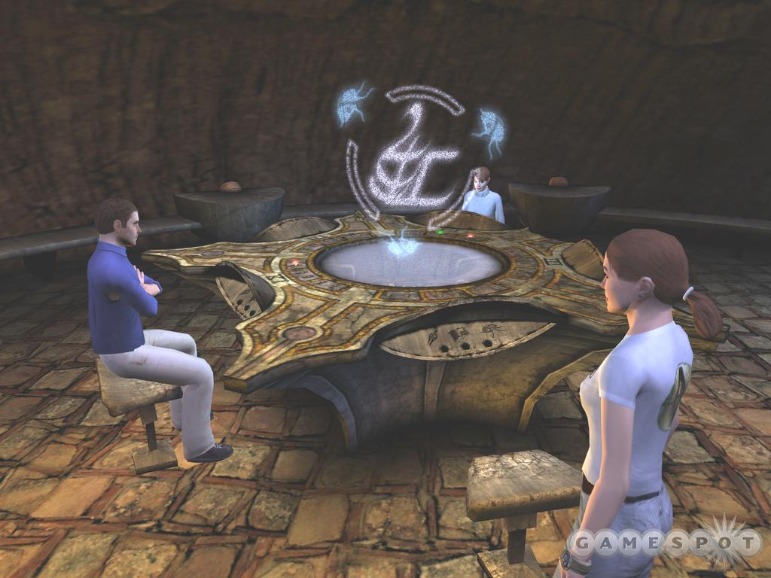
Multiplayer games, learning from others?
Uru: Ages Beyond Myst

Slide 12
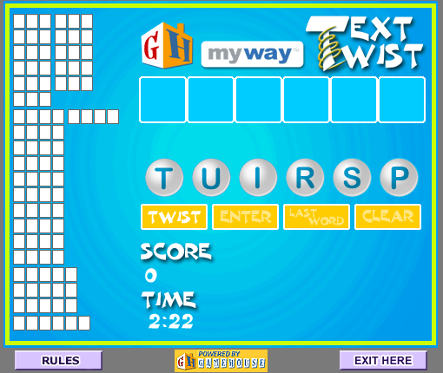
Addiction and learning…
TextTwist

Slide 13
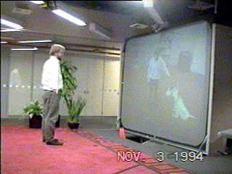

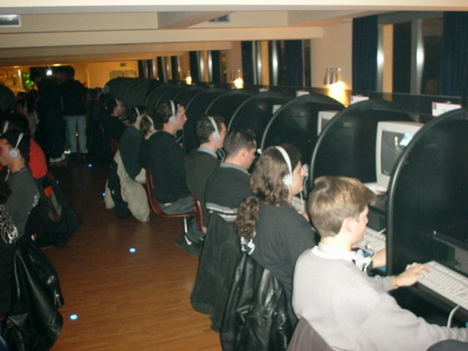

Platforms: console, mobile, virtual, LAN, internet, PC

Slide 14
Motivation implies engaging (fun) implies rapid prototyping
How to make games fun?
  Design it, build it, try it, refine it, try it again, and again and again.
  Will Wright and the SIMS (11 times!!!)
Break the cycle! (Increase budget -> decrease risk -> decrease creativity)
Not about:
  High quality visuals
    While compelling, the bar continues to be raised and it’s impossible to compete.
    Does it still need to be above bar (Discuss!)
  Spoon fed learning
    Need to build in learning content implicitly into the experience, not stop and drill and then proceed.
    What content appropriate: (Discuss!)
    Skills, not necessarily knowledge: Critical Thinking, Logic, Discourse, Choice, etc.
  Not everybody responds to the same types of situations: (Discuss!)
Lower the barrier for rapid prototyping of games:
  Rapid Prototyping Languages
  Game Modding
  Licensing Game Engines
  Alternate Platforms

Slide 15
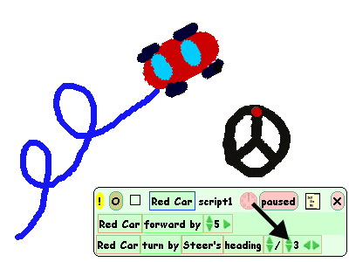
Rapid prototyping systems & languages
Languages: Lisp/Scheme/Python/Smalltalk/Squeak/Scratch/Glyph/Proce77ing
Platforms: Flash/Director, Project Fun’s FunEditor. See refs:
Audience: Amateur developers
PROS:
  Allow people to quickly realize their visions
  Can be used successfully in games (Naughty Dog Productions)
  Great for kids to learn (Squeak, Logo, etc.)
  Great for teaching programming.
CONS:
  Yet another language to learn
  Few people are experts in the language to start with, difficult to draw on other people’s work
  Hard to do projects that scale
CONCLUSION:
Great for getting started. Needs to be built into existing engines
Notes:
http://www.franz.com/success/customer_apps/animation_graphics/naughtydog.lhtml

Slide 16
Game Modding
Altering an existing game with publicly supported tools. Mod tools exist for Half-Life, Unreal, Dungeon Siege, Baldur’s Gate, and many other games (see refs)
Audience: Amateur developers, Some teachers
PROS:
  Don’t need the same level of programming expertise.
  Can allow you to iterate much faster
  Good community support
CONS:
  Difficult to adapt much beyond the original game format
  Little professional support
  Can still involved intricate programming
CONCLUSION:
  Need to encourage developers to incorporate this ability into their games

Slide 17
Game Engines
Start with an existing engine: Either professional or open source and development game on top of this. Many engines exist (see refs)
Audience: Amateur to professional developers
PROS:
  Jump starts development time, lets you build on many other people’s work, can include sophisticated rendering, model importing, simulation tools
  Multiplatform: Important for delivery implications
CONS:
  Can be hard to understand existing engine
  Can require sophisticated programming expertise
  May be difficult to adapt to your needs
  Primarily first person shooter or 3rd person RPG engines
  CONCLUSIONS:
  Need more and varied engines.

Slide 18
Alternative platforms
  Small downloadable games: (TextTwist, Bejeweled, etc.)
  Mobile games: (Environmental Detectives)
  Audience: Amateur to professional developers
  PROS:
    Less polished interfaces, more opportunity to iterate and innovate
    Less established standards
  CONS:
    Need to start development from scratch,
    Need specific domain expertise (how to program on a portable device, use of gps, etc)
    Not necessarily suited for all domains
    Less established standards (pro & con)
  CONCLUSIONS:
    Need to explore portability and cross development experiences

Slide 19
Answers?
No answers, only tradeoffs:
Mods good for starting out and getting something that looks good for different content, but may be difficult to adapt beyond original purposes.
Need multitalented teams working together. Programmers, designers, domain experts.
Few facts about what works. Need to use intuition, access to people who’ve had successes. Experiment!
Opportunities:
Create some killer examples (that aren’t first-person killer games) to lead the way.
For developer community: better rapid prototyping tool support
Need more diverse engines:
Sim Engine – is it amenable to generalization?
Encourage developers to continue to make engines modifiable
Appropriate economic model to spur better development!!

Slide 20
References: Useful websites:
International Game Developers Association: http://www.igda.org
Computer Game Developers http://www.gamasutra.com
GameDev.Net http://www.gamedev.net
Game Discovery http://www.gamediscovery.com/
GDSE: Game Programming and Design Search Engine: http://www.gdse.com
Extreme Tech http://www.extremetech.com/
Python Game Development: www.pygame.org
Simulation/Gaming Resources: http://sg.comp.nus.edu.sg/
Historical Simulations: http://www.muzzylane.com
Games with an agenda: http://www.watercoolergames.org/
Serious games: http://www.seriousgames.org/

Slide 21
References: Game Engines
  Game Engines for Licensing: Good discussions in http://www.extremetech.com/article2/0,1558,1156337,00.asp
  http://www.cyberloonies.com/game-engines.html
  Some highlights:
  Torque Game Engine: www.garagegames.com/pg/product/view.php?id=1
  Quake III: www.idsoftware.com
  Unreal: http://udn.epicgames.com/pub/Engine/WebHome/
  Gamebryo: http://www.ndl.com/forpublishers.cfm
  Touchdown Entertainment (formerly Lithtech): www.touchdownentertainment.com
  Renderware: http://www.renderware.com/
  DarkBASIC Professional: http://darkbasicpro.thegamecreators.com/
  Panda3D:

Slide 22
References: Game mods:
Valve: Half-life: www.planethalflife.com/, http://www.valve-erc.com/
Unreal: www.planetunreal.com/ , www.unreal.gamedesign.net www.unrealed.net
Dungeon Siege: http://www.siegeworks.org/index.php
Baldur’s Gate/Neverwinter Nights: http://www.bioware.com http://www.planetneverwinter.com/

Slide 23
References: Rapid Prototyping Systems
    Flash, Director: http://www.macromedia.com
    Game Dev System: http://projectfun.digipen.edu/
    Squeak: http://www.squeakland.org/
    Python: http://www.pygame.org
    Alice: http://www.alice.org
    Scratch: http://llk.media.mit.edu/projects/summaries/scratch.shtml
    Proce77ing: http://processing.org/

Slide 24
References: Books
Digital Game-Based Learning: Marc Prensky
Rules of Play: Katie Salen and Eric Zimmerman
Chris Crawford on Game Design
What Video Games have to Teach us about Learning and Literacy: James Paul Gee
Simulations and the Future of Learning: Clark Aldrich
Interactive Storytelling: Andrew Glassner
Countless game development references:
Beginning .NET Game programming with C#, David Weller et al.
Game Engine Design: David Eberly
AI Game Development: Alex Champandard
Game Coding Complete: Mike McShaffry
Game Physics: David Eberly
Game Scripting Mastery: Alex Varanese
Game Programming Gems
Game Development Series:

